Slide 1
The International Economy and Globalization

Slide 2
The International Economy
High degree of economic interdependence
No nation exists in economic isolation
All aspects of a nation’s economy are linked to the economies of its trading partners
Reflects the historical evolution of the world’s economic and political order
Complex and its effects uneven

Slide 3
The International Economy
High degree of economic interdependence
Steps toward international cooperation
Mutually advantageous for trading nations
Specialization, efficiencies of large scale production
Wider variety of products at lower cost
Protectionist pressures
Developing nations
Liberalized trading system - serves to keep the developing nations in poverty

Slide 4
Globalization of Economic Activity
Globalization
Greater interdependence
Countries and their citizens
International flows
Goods and services
People
Investments in equipment, factories, stocks, bonds
Non-economic elements
Culture and the environment

Slide 5
Globalization of Economic Activity
What forces are driving globalization?
Technological change
Multilateral trade negotiations
Continuing liberalization of trade and investment
Widespread liberalization of investment transactions
Development of international financial markets

Slide 6
Waves of Globalization
First Wave of Globalization: 1870–1914
Decreases in tariff barriers & new technologies
Declining transportation costs
Shift from sail to steamships; Railways
Driven by European and American businesses and individuals

Slide 7
Waves of Globalization
First Wave of Globalization: 1870–1914
Exports as a share of world income
Nearly doubled to 8%
Per capita incomes increased 1.3% per year
Previous 50 years: 0.5% per year
Countries that actively participated in globalization
Became the richest countries in the world
Brought to an end by World War I

Slide 8
Waves of Globalization
Great Depression of the 1930s
Governments – protectionism
Tariffs on imports
Try to shift demand into domestic markets
Promote sales for domestic companies
Promote jobs for domestic workers
Exports as a share of national income
Falls to 5%

Slide 9
Waves of Globalization
Second Wave of Globalization: 1945–1980
Horrors of the retreat into nationalism
Falling transportation costs
Decrease previously established trade barriers
Trade liberalization – discrimination
Which countries participated
Which products were included

Slide 10
Waves of Globalization
Trade liberalization – discrimination
Developed countries, manufactured goods
Largely freed of barriers
Greatly increased the exchange of manufactured goods
Raise the incomes of developed countries
Developing countries
Eliminate barriers only for those agricultural products that did not compete with agriculture in developed countries
Manufactured goods - sizable barriers

Slide 11
Waves of Globalization
Second Wave of Globalization: 1945–1980
New kind of trade
Rich country specialization in manufacturing niches
Gained productivity through agglomeration economies
Firms clustered together
Some clusters produced the same product
Others were connected by vertical linkages
Agglomeration economies
Benefit those in the clusters
Bad news for those who are left out

Slide 12
Waves of Globalization
Second Wave of Globalization: 1945–1980
Most developing countries
Did not participate in the growth of global trade in manufacturing and services
Continuing trade barriers in developed countries
Unfavorable investment climates
Antitrade policies in developing countries
Dependence on agricultural and natural-resource products

Slide 13
Waves of Globalization
Second Wave of Globalization: 1945–1980
Increased per capita incomes within the developed countries
Developing countries as a group were being left behind
World inequality

Slide 14
Waves of Globalization
Latest Wave of Globalization, began in 1980
A large number of developing countries
China, India, and Brazil
Broke into the world markets for manufacturers
Other developing countries
Increasingly marginalized in the world economy
Decreasing incomes
Increasing poverty
Significant international capital movements

Slide 15
Waves of Globalization
Latest Wave of Globalization, began in 1980
Some developing countries
Competitive advantage in labor-intensive manufacturing
Bangladesh, Malaysia, Turkey, Mexico, Hungary, Indonesia, Sri Lanka, Thailand, and the Philippines
Tariff cuts
Lower barriers to foreign investment
Technological progress in transportation and communications
Protectionist policies in developed countries

Slide 16
Waves of Globalization
Latest Wave of Globalization, began in 1980
World
More globalized - international trade, capital flows
Less globalization - labor flows
Foreign outsourcing
Certain aspects of a product’s manufacture are performed in more than one country
Manufacturing - moved to wherever costs were the lowest
Job losses for blue-collar workers
Cries for the passage of laws to restrict outsourcing

Slide 17
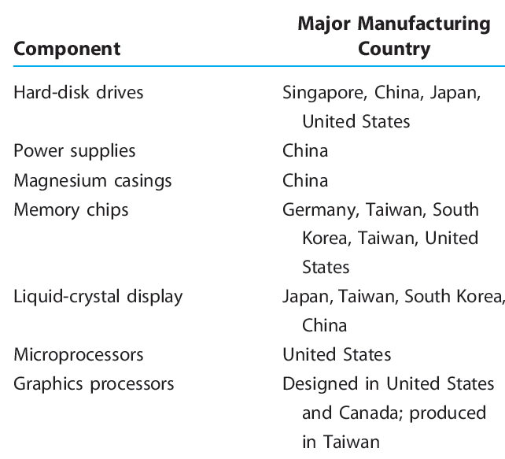
Manufacturing an HP Pavilion, ZD8000 laptop computer
TABLE 1.1

Slide 18
Waves of Globalization
Latest Wave of Globalization, began in 1980
By the 2000s, foreign outsourcing of white-collar work
Information Age
Digitization, Internet, and high-speed data networks around the world
Sending upscale jobs offshore
Accounting, chip design, engineering, basic research, and financial analysis
Foreign outsourcing
Reduce costs of a given service: 30 to 50%

Slide 19
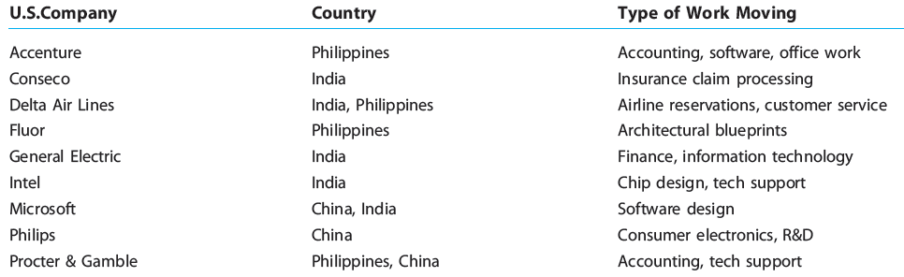
Globalization goes white collar
TABLE 1.2

Slide 20
Why Is Globalization Important?
Law of comparative advantage
Citizens of each nation can gain
Spend more of their time and resources doing those things in which they have a relative advantage
If a good or service can be obtained more economically through trade
Trade for it instead of producing it domestically
How the available resources can be used to obtain each good at the lowest possible cost

Slide 21
Why Is Globalization Important?
Open economies
Produce a larger joint output
Competition - essential to both innovation and efficient production
International competition
Domestic producers - strong incentive to improve the quality of their products
Weakens monopolies

Slide 22
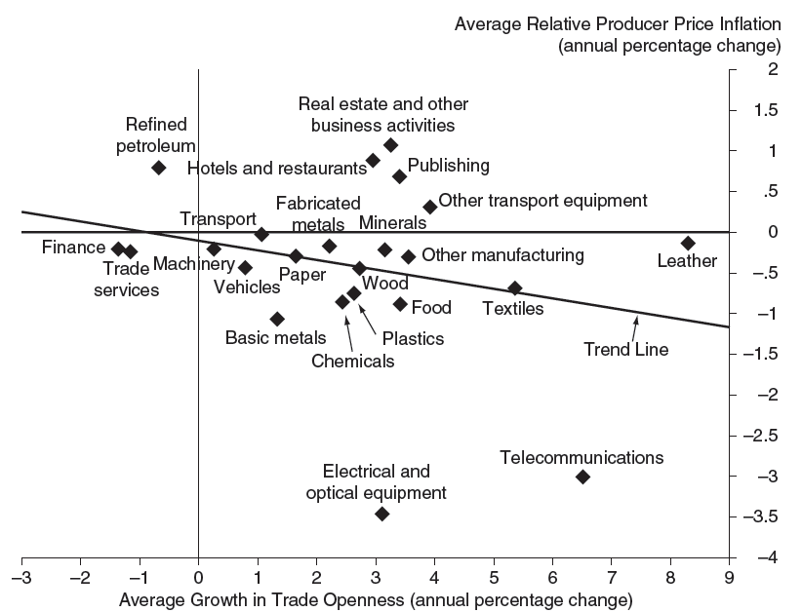
Global competition lowers inflation
FIGURE 1.2
World imports relative to U.S. consumption have doubled over the past four decades, making more of what consumers purchase subject to increased competition inherent in international trade. This added competition tends to hold down the cost of goods and services as seen for the period 1987 to 2003.

Slide 23
Why Is Globalization Important?
Open economies
More competition
More firm turnover
Improvements for the industry
Economic growth rates - close relation to:
Openness to trade
Education
Communications infrastructure

Slide 24
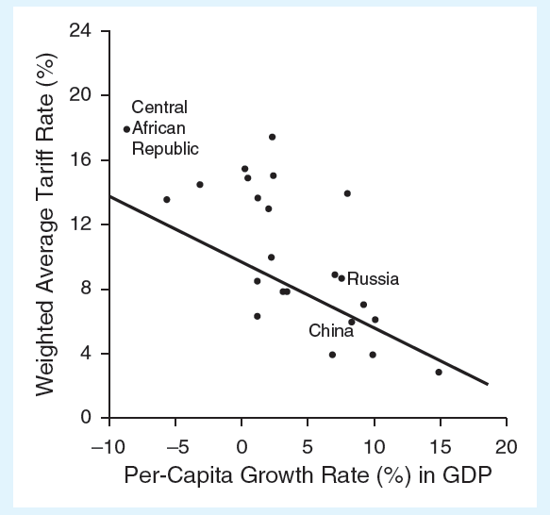
Tariff barriers versus economic growth
FIGURE 1.3
The figure shows the weighted average tariff rate and per-capita growth rate in GDP for 23 nations in 2002. According to the figure, there is evidence of an inverse relationship between the level of tariff barriers and the economic growth of nations.

Slide 25
Why Is Globalization Important?
Globalization
Rapid growth in some countries
Increased demand for commodities
Crude oil, cooper, steel - higher prices
Increased supply of substitutes
Biodiesel, ethanol
Domestic economy
Vulnerable to disturbances initiated overseas
Increased competition from abroad
Schwinn Bicycle Company, Dell Computer Corporation

Slide 26
The Global Recession of 2007 – 2009
Immediate cause of the global economic crisis
Collapse of the U.S. housing market
Resulting surge in mortgage loan defaults
Undermined the financial institutions that originated and invested in them
Creditors and uninsured depositors
Pulled their funds and cashed out of securities issued by risky institutions
Invested in U.S. Treasury securities

Slide 27
The Global Recession of 2007 – 2009
Immediate cause of the global economic crisis
Many institutions failed, others struggled to survive
Banks - fearful about making loans
The credit spigot closed
The global economy withered
Global stock investors dumped their holdings
Self-reinforcing adverse economic downturn
Crisis in confidence

Slide 28
The Global Recession of 2007 – 2009
Roots of the problem
Lack of fear - booming housing market of 2006
Mortgage-backed securities
Booming housing market
Government pressured banks to serve poor borrowers and poor regions of the country
Community Reinvestment Act
Default mortgages

Slide 29
The Global Recession of 2007 – 2009
The crisis goes global
Europe
Exposure to defaulted mortgages in the U.S.
Emerging economies
Lacked resources
Extremely poor countries
Decrease in foreign aid
China - depressed its export markets
Crisis in confidence

Slide 30
The Global Recession of 2007 – 2009
Combating a crisis in confidence
Pump liquidity into troubled financial institutions
Provide increased or unlimited deposit insurance
Central banks
Coordinated interest-rate reductions
Purchased commercial paper & money market instruments

Slide 31
The Global Recession of 2007 – 2009
Combating a crisis in confidence
Governments
Large fiscal stimulus packages
Tax cuts
Increased government spending
International Monetary Fund
Financial aid to emerging countries

Slide 32
Common Fallacies of International Trade
“Trade is a zero-sum activity”
Both partners gain from trade
“Imports reduce employment and act as a drag on the economy, while exports promote growth and employment”
Failure to consider the link between imports and exports

Slide 33
Common Fallacies of International Trade
“Tariffs, quotas, and other import restrictions will save jobs and promote a higher level of employment”
Failure to recognize that a reduction in imports does not occur in isolation
Free trade
Increases competition, lowers prices
Makes better products available to consumers
Higher consumption

Slide 34
Does Free Trade Apply to Cigarettes?
Free cigarettes trade
Higher consumption
More smoking, disease, and death
Globally - 4 million people die each year from:
Lung cancer, emphysema
Other smoking-related diseases
Antismoking activists
Cigarettes are “bads”
Require their own set of regulations
Benefits of free trade do not apply to cigarettes

Slide 35
Does Free Trade Apply to Cigarettes?
World Health Organization
Some nations
Support provisions to emphasize antismoking measures over free-trade rules
United States
Promoted freer trade in cigarettes
Challenged rules imposed to aid local cigarette makers
Current trade rules
Countries can enact measures to protect the health and safety of their citizens

Slide 36
Is International Trade an Opportunity or a Threat to Workers?
International trade benefits many workers
Cheaper consumption goods
Employers – better technologies and equipment
Workers - more productive
Exports - generates jobs and income for domestic workers

Slide 37
Is International Trade an Opportunity or a Threat to Workers?
Not all workers gain from international trade
Cheap imports
Rising unemployment and wage inequality
Threatening to unskilled workers in the import-competing sectors
Lobby to restrict imports

Slide 38
Is International Trade an Opportunity or a Threat to Workers?
International trade
Domestic prices - aligned with international prices
Wages increase
Workers whose skills are scarce
Wages decrease
Workers who face increased competition
Jobs lost in one industry
Replaced by jobs gained in another industry

Slide 39
Is International Trade an Opportunity or a Threat to Workers?
The long-run effect of trade barriers
Does not increase total domestic employment
Reallocates workers
Away from export industries
Toward less efficient, import-competing industries
Leads to a less efficient utilization of resources
International trade
Just another kind of technology
Adds value to its inputs

Slide 40
Backlash Against Globalization
Proponents of free trade and globalization
Countries prosper
New ideas and technology flow freely around the world
Productivity growth
Increasing living standards
Lower consumer prices
Increased variety of goods and services

Slide 41
Backlash Against Globalization
Critics of free trade and globalization
Benefit large corporations
Rather than average citizens
Environmentalists
Elitist trade organizations make undemocratic decisions
Undermine national sovereignty on environmental regulation
Unions
Unfettered trade permits unfair competition

Slide 42
Backlash Against Globalization
Critics of free trade and globalization
Human rights activists
World Bank and International Monetary Fund support governments that:
Allow sweatshops
Pursue policies that bail out governmental officials at the expense of local economies

Slide 43
Advantages and disadvantages of globalization
TABLE 1.6
Advantages | Disadvantages
Productivity increases faster when countries produce goods and services in which they have a comparative advantage. Living standards can increase more rapidly. Global competition and cheap imports keep a constraint on prices, so inflation is less likely to disrupt economic growth. An open economy promotes technological development and innovation, with fresh ideas from abroad. Jobs in export industries tend to pay about 15 percent more than jobs in import-competing industries. Unfettered capital movements provide the United States access to foreign investment and maintain low interest rates. | Millions of Americans have lost jobs because of imports or shifts in production abroad. Most find new jobs that pay less. Millions of other Americans fear getting laid off, especially at those firms operating in import-competing industries. Workers face demands of wage concessions from their employers, which often threaten to export jobs abroad if wage concessions are not accepted. Besides blue-collar jobs, service and white-collar jobs are increasingly vulnerable to operations being sent overseas. American employees can lose their competitiveness when companies build state-of-the-art factories in low-wage countries, making them as productive as those in the United States.

Slide 44
Terrorism Jolts the Global Economy
Continuing terrorism
Companies – increased security costs
Heightened border inspections
Slow shipments of cargo
Companies - stock more inventory
Tighter immigration policies
Reduce inflows of skilled and blue-collar laborers
Greater preoccupation with political risk
Companies – fewer investments

Slide 45
Terrorism Jolts the Global Economy
International trade
Weapon in the war against terrorism in the long-run
Increasing living standards in impoverished regions
Eliminating an important cause of war and terror

Slide 46
Competition in the World Steel Industry
1982, average cost per ton of steel
U.S. producers: $685 per ton
52% higher than for Japanese producers
Cost differential
Strong U.S. dollar
Higher U.S. costs of labor (25% of total cost)
Higher U.S. cost of raw materials (45% of total cost)
High fixed costs of production

Slide 47
Competition in the World Steel Industry
U.S. steelmakers
Reduce production costs, regain competitiveness
Long-term contracts for raw materials (lower prices)
Labor contracts - 20 to 40 percent improvement in labor productivity
Problems
Large unfunded pension obligations
Large healthcare costs for retirees
Shrinking employee base

Slide 48

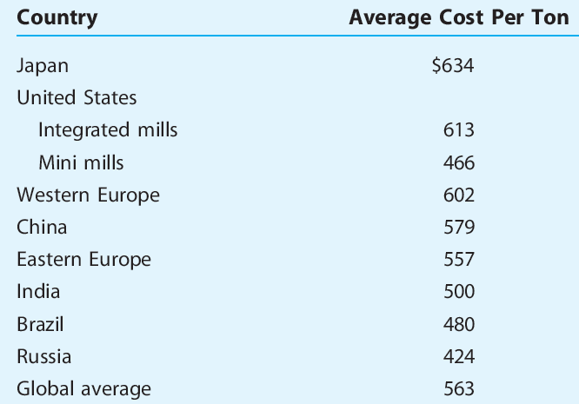
World steel cost comparisons: cost per ton of steel, 2009
TABLE 1.7

